Slide 1
Fusilli development
Multi-figure with
Side bar
Front page
Example of model descriptions
Outputs of the models themselves
Reals vs preds
Kfold
Comparison

Slide 2
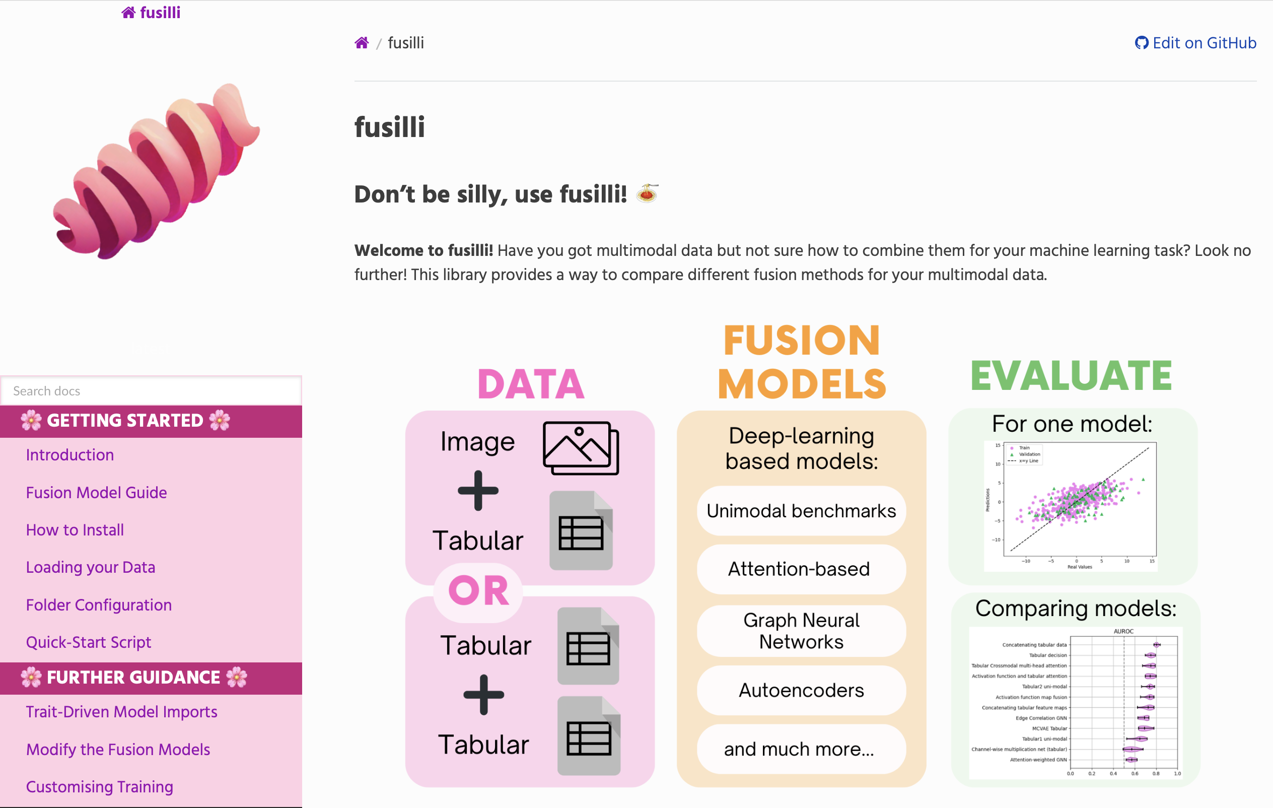
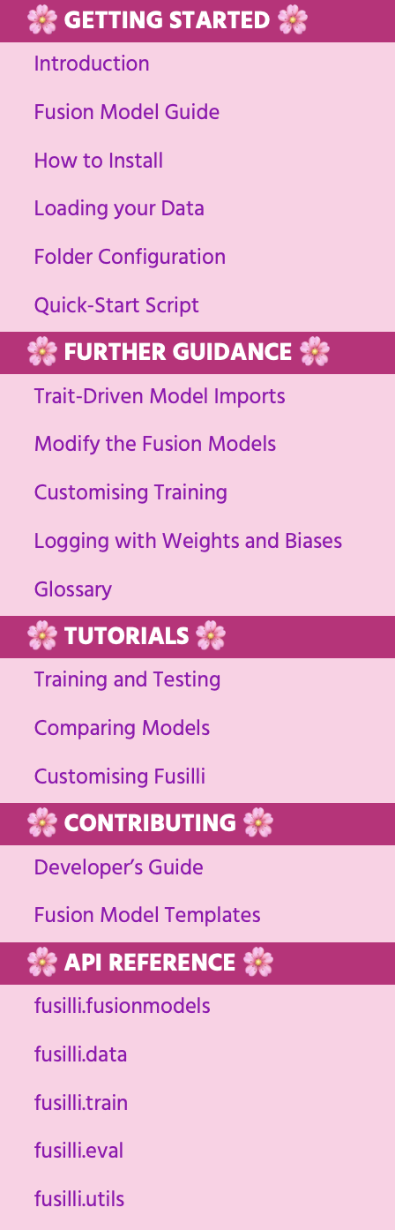
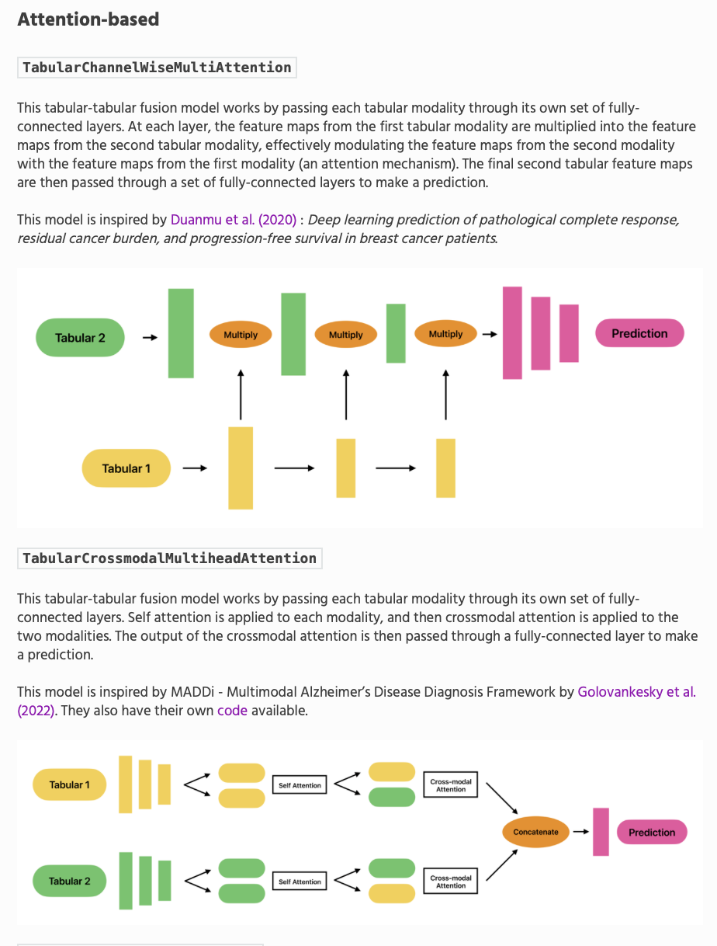
A
C
B

Slide 3
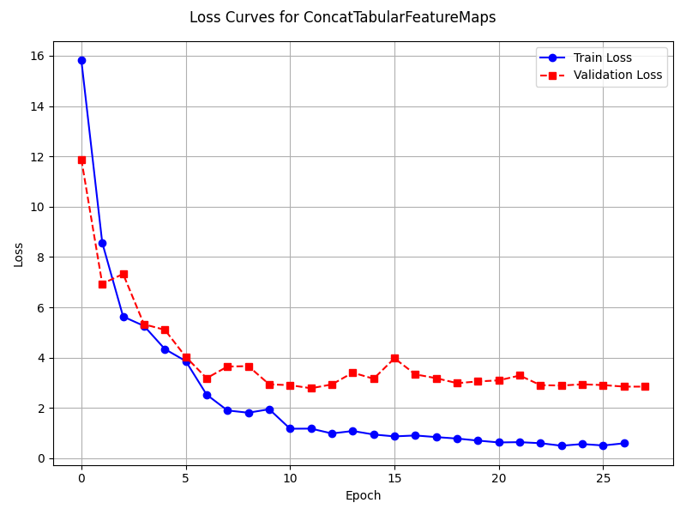
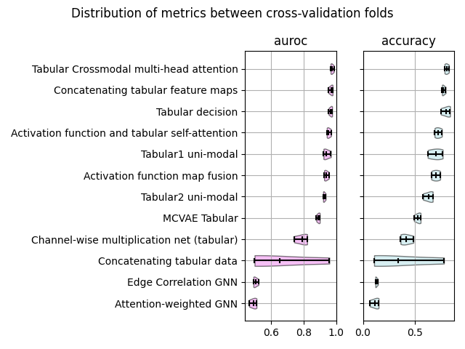
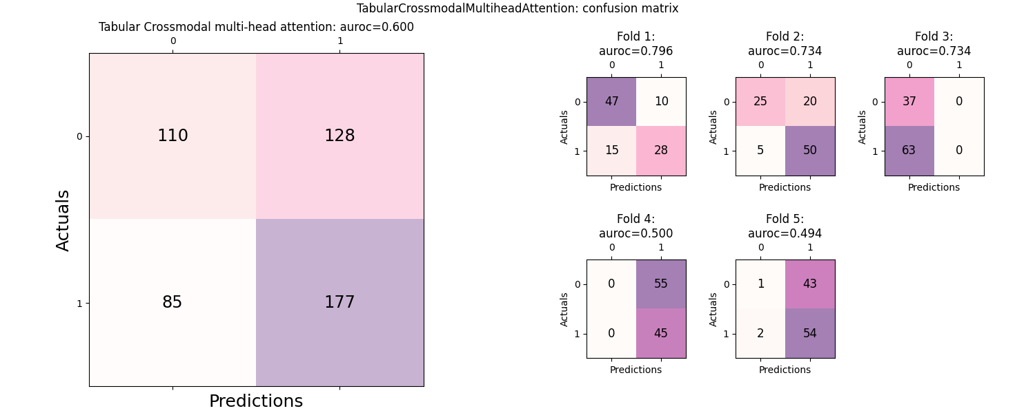
A
C
B

Slide 4
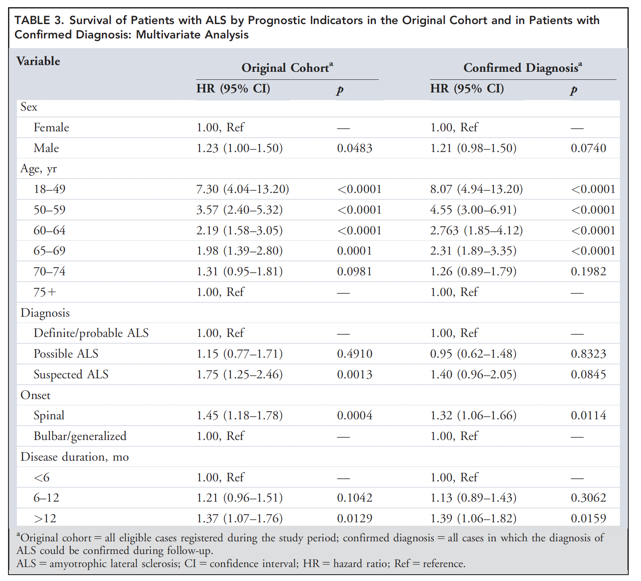
Cox Models
Table of factors for all models
Kaplan meier curves for significant factors in all models
Table of fit statistics

Slide 5
Fusilli MND
Model architectures

